Slide 1
Learning a driving simulator
Eder Santana, George Hotz
presented by Mike Doan

Slide 2
Self driving, a primer
Level 0: You drive. Car sleeps.
Level 1: Car helps a little. You're still babysitting.
Level 2: Car drives straight. You handle the hard stuff.
Level 3: Car drives. You're the backup human.
Level 4: Car drives itself. You're just cargo (sometimes).
Level 5: Car is better than you. Steering wheel optional.
thanks claude <3

Slide 3
A brief history of self driving
1980s-2000s: rule based systems.
2000s-early 2010s: transition period. shallow learning.
"when you think MobileEye, think Cone Guy™"
2010s-2020s: DEEP LEARNING.
Waymo, Tesla, Comma.
2020s-present: Cone Guy™ gets fired.
Self driving Waymos take over SF.

Slide 4
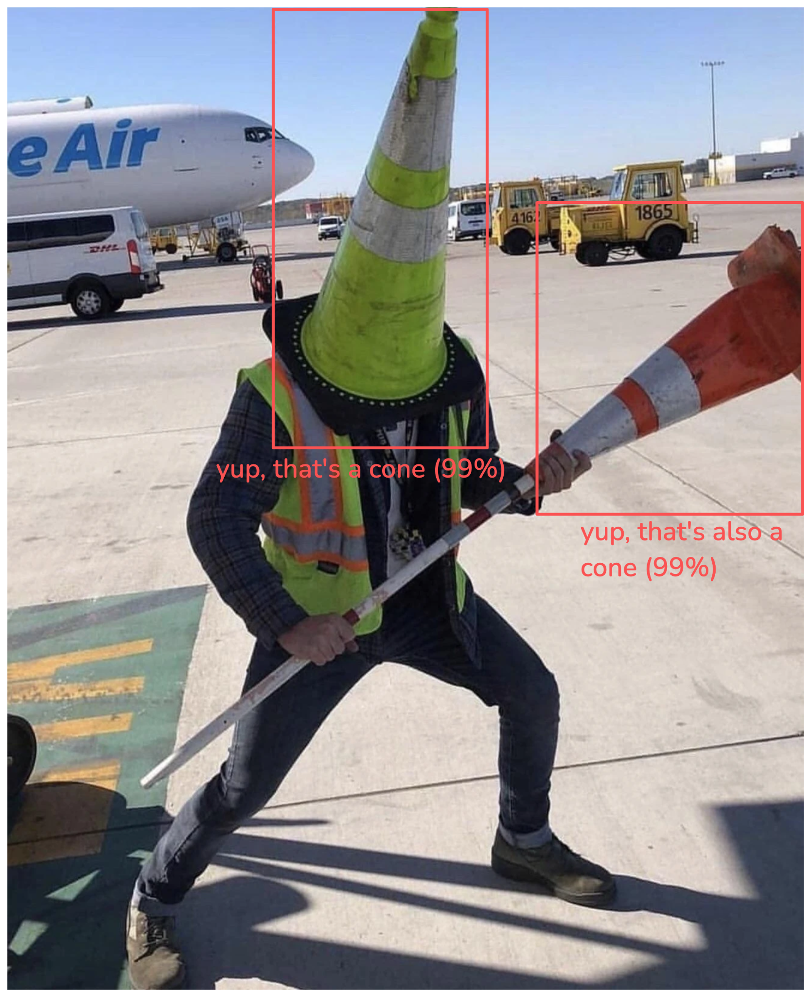
Cone Guy™
1. Find the cone (or any other object)
2. Write a policy for cones
3. Repeat for all objects
4. Hope that this is computationally
tractable
5. ?????
6. Level 5 self driving!!!!!

Slide 5
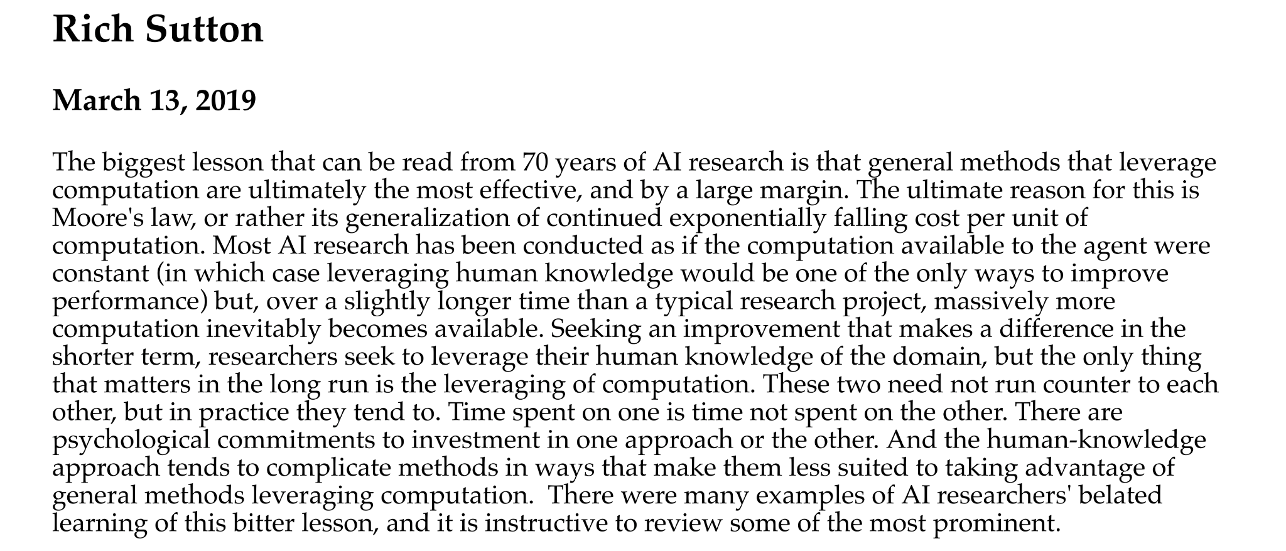
Bitter Lesson

Slide 6
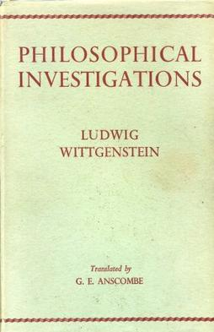
The original Bitter Lesson
Rule based systems did not work (for driving).
Symbolic reasoning in general does not scale to actual problems. but let's not talk about that.
Policy for driving not tractable to handwritten rules
Something something Minsky AI winter.
Cone Guy™ had it coming.

Slide 7
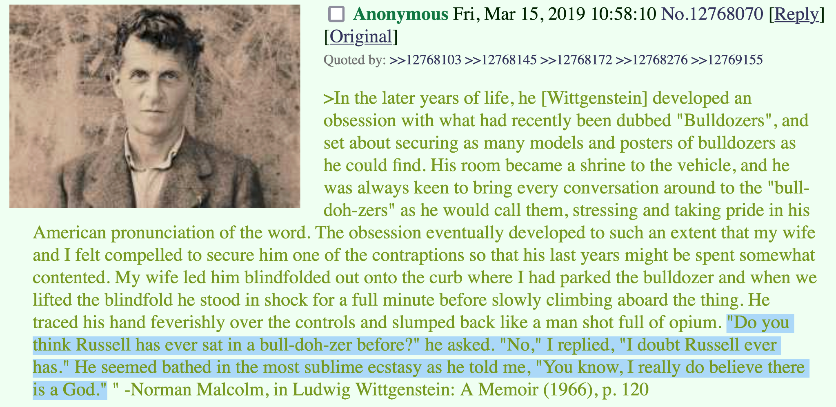
Wittgenstein might've also been crazy

Slide 8
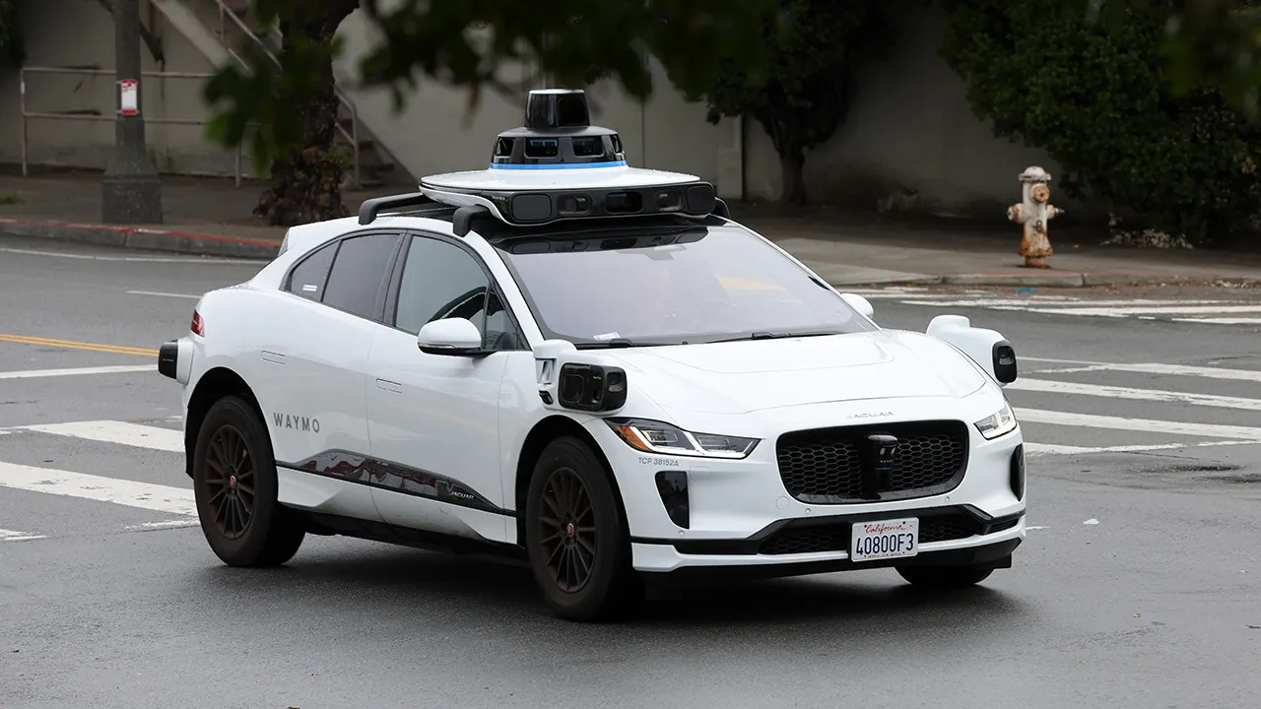
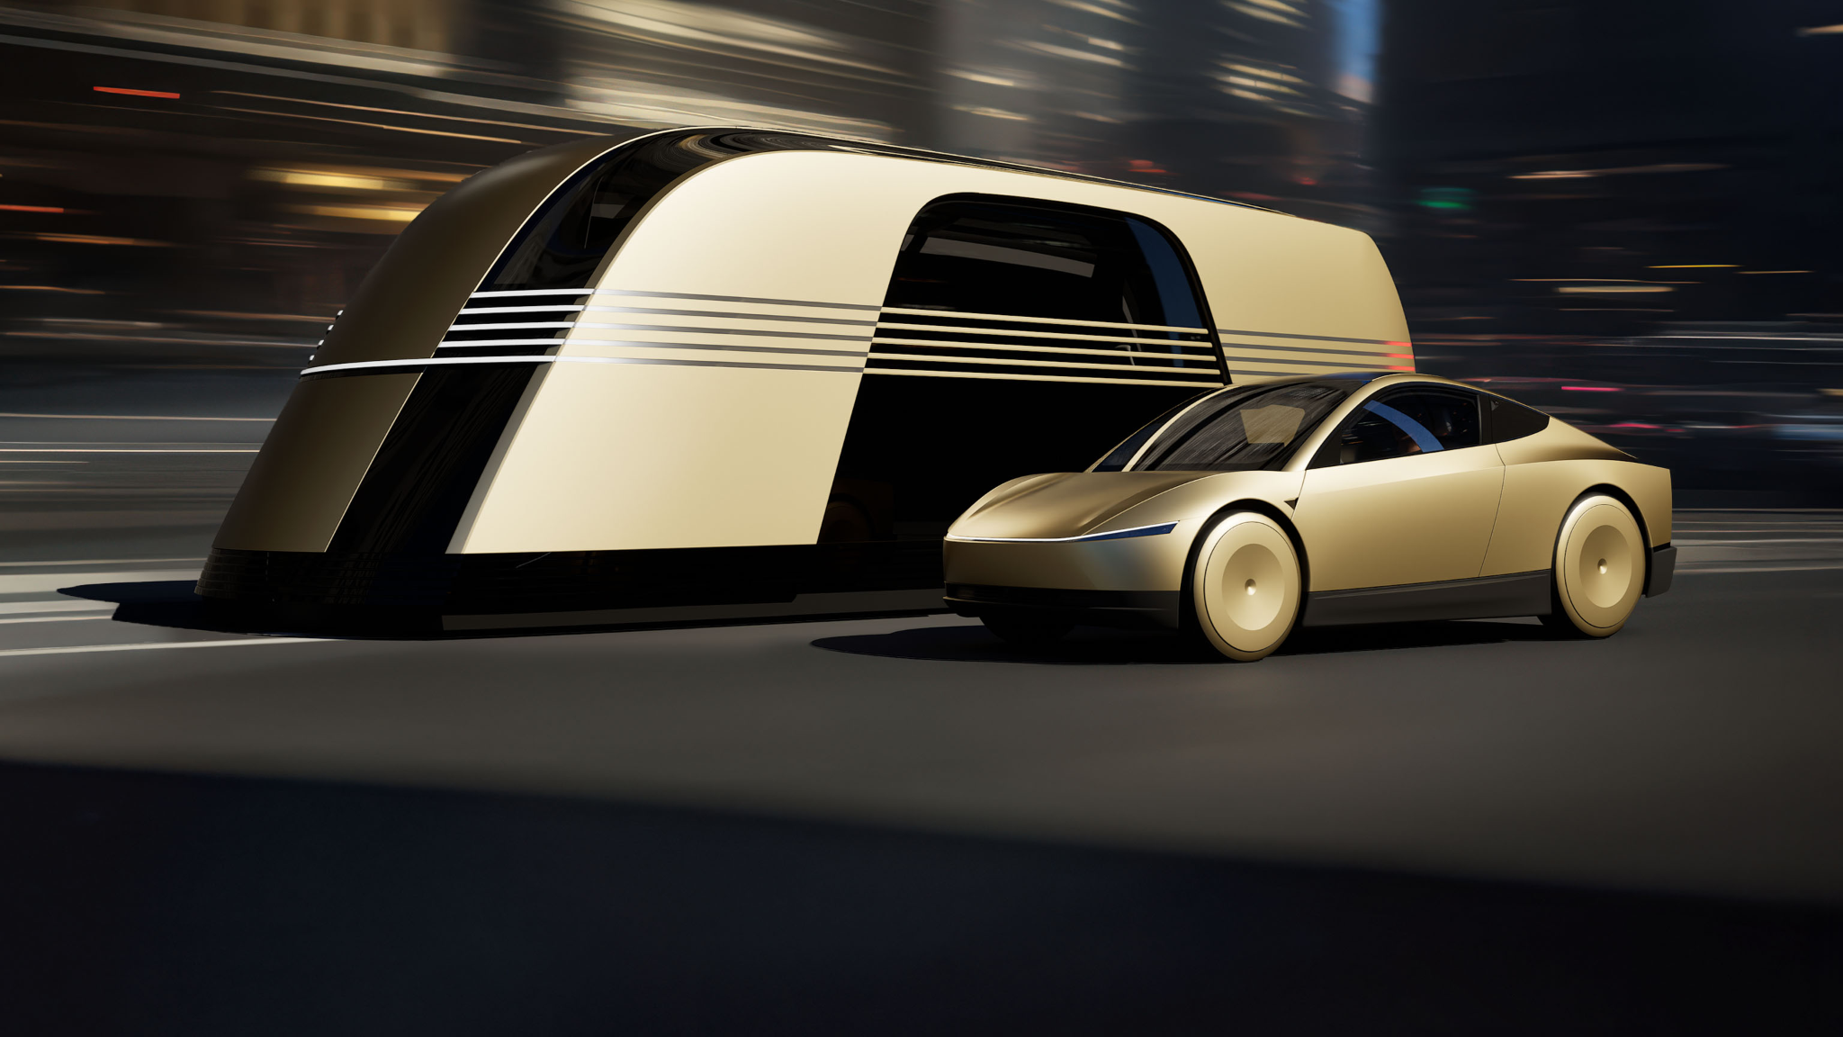
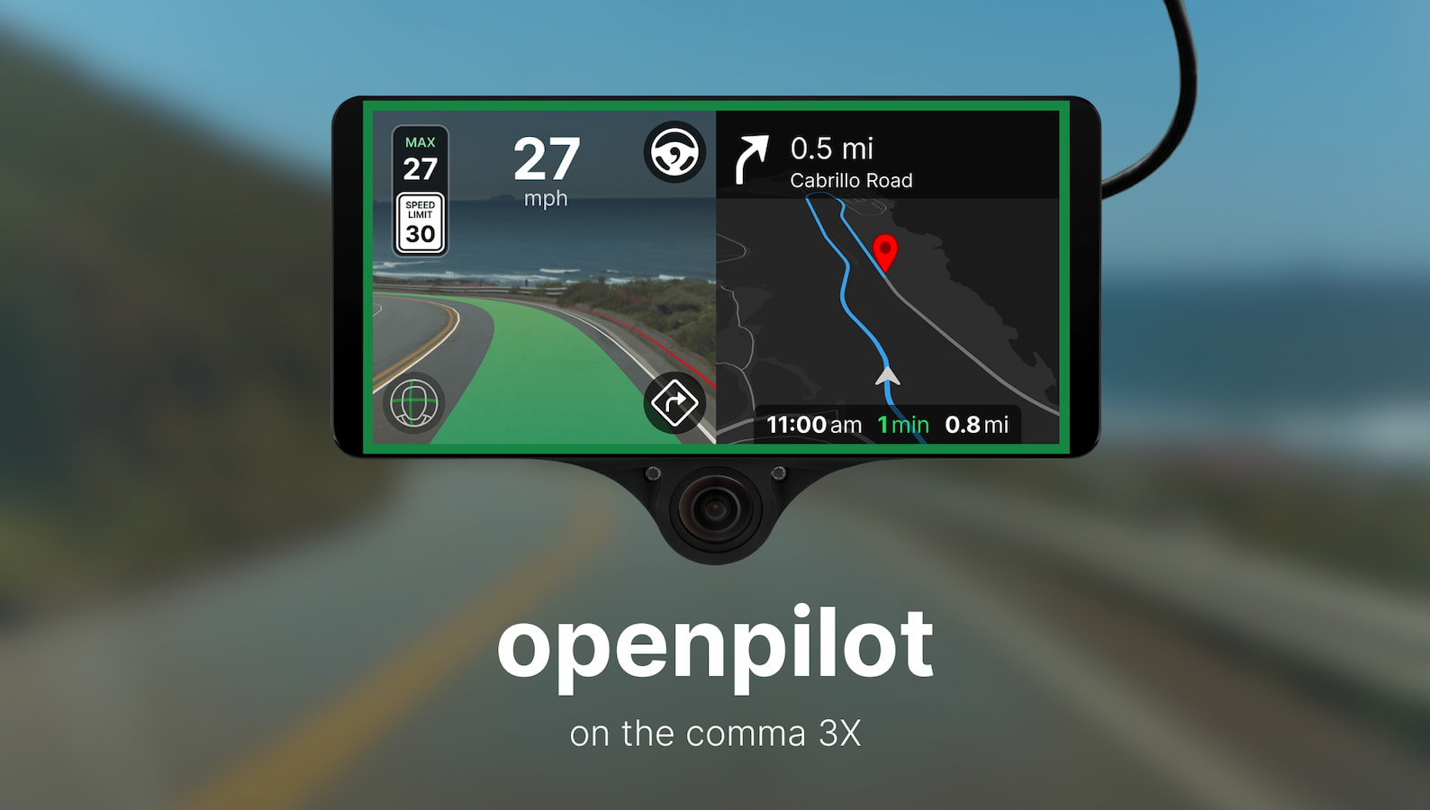
Deep Learning 'works' for self driving
It totally works just give me your vc funding

Slide 9
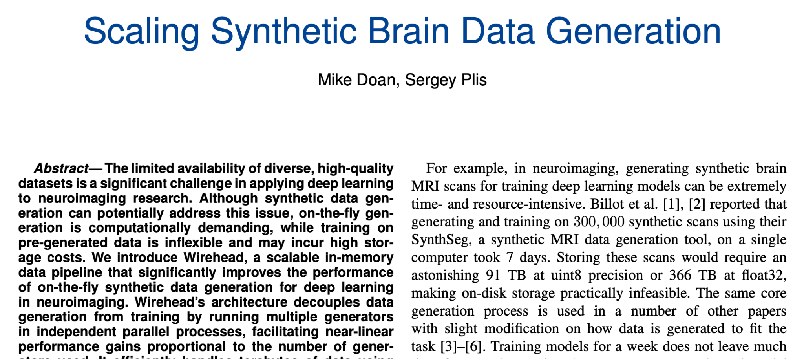
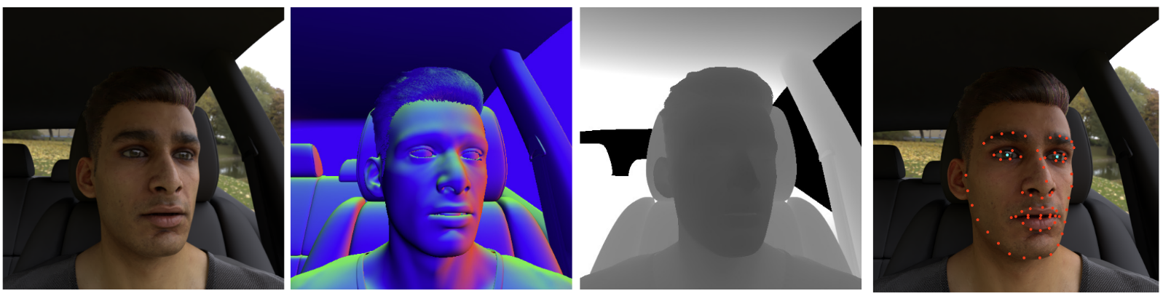
So, about synthetic data
It works, if you're careful.
Mode collapse, domain shift, something something data interpolation.
> Empirically, it works. Though it "doesn't" in theory.

Slide 10
The Driving Simulator

Slide 11
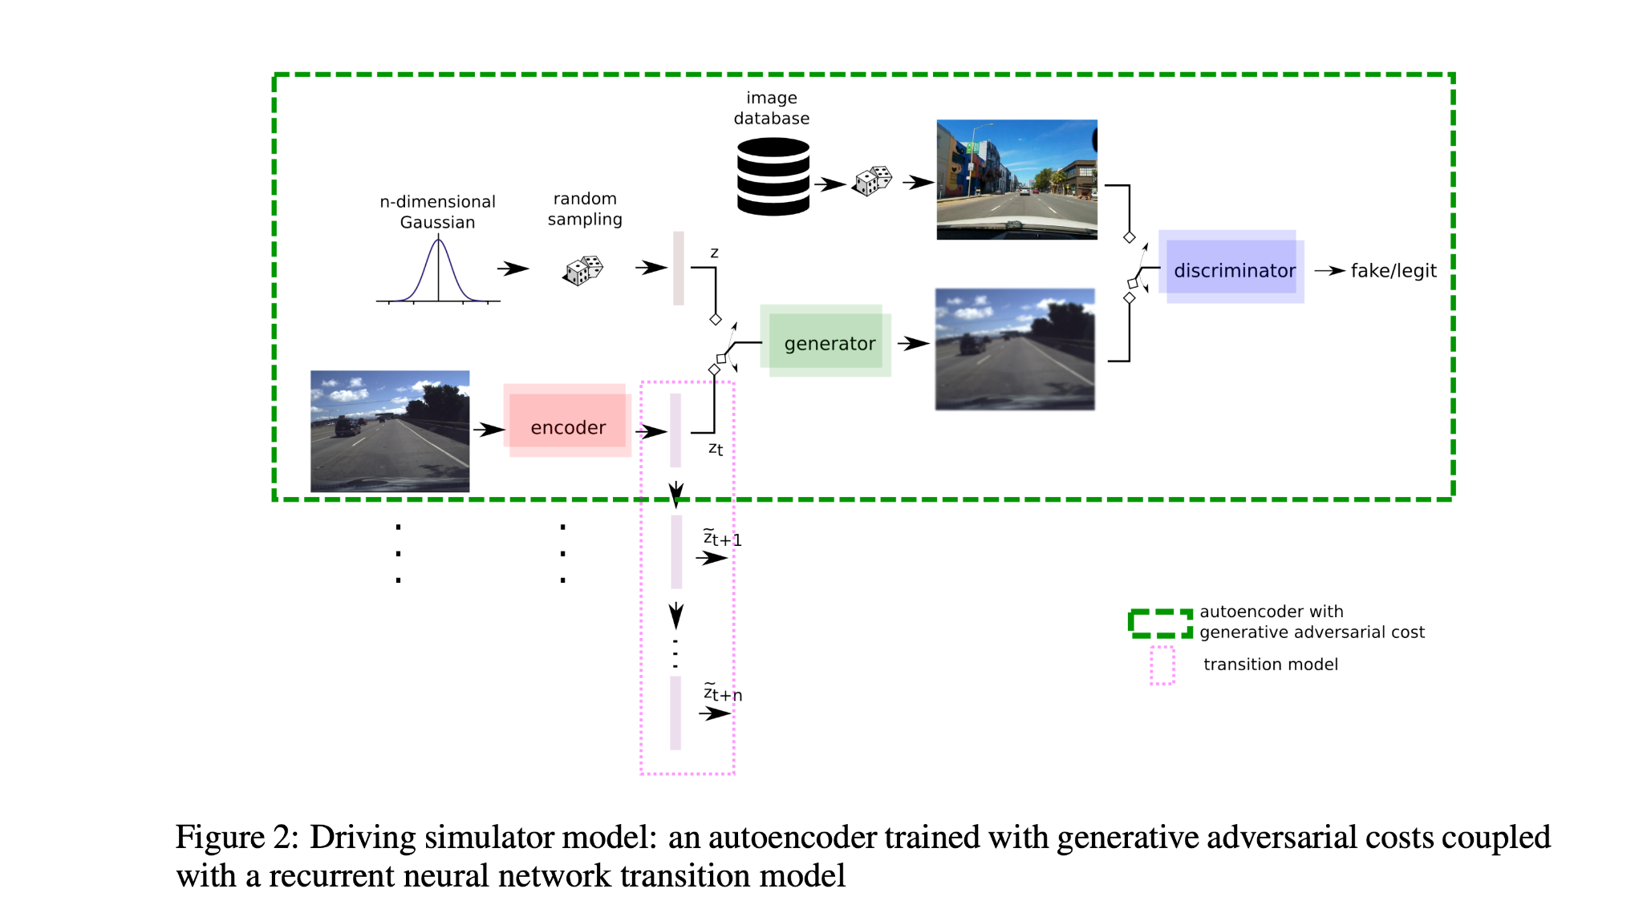
The simulator

Slide 12
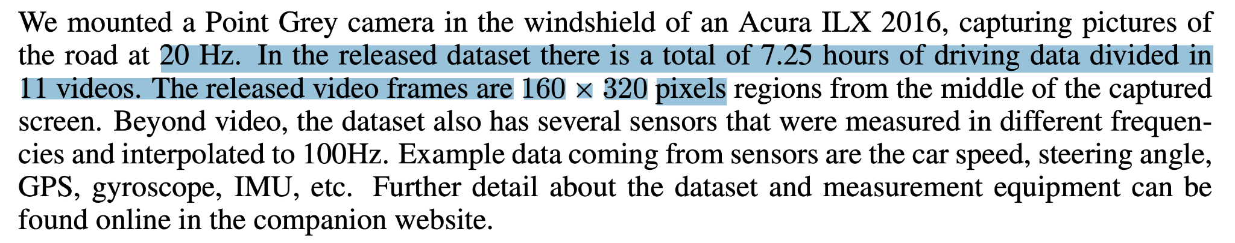
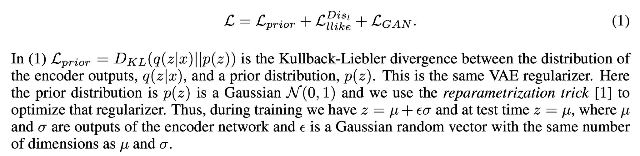
Vision model (aka 'representation')

Slide 13
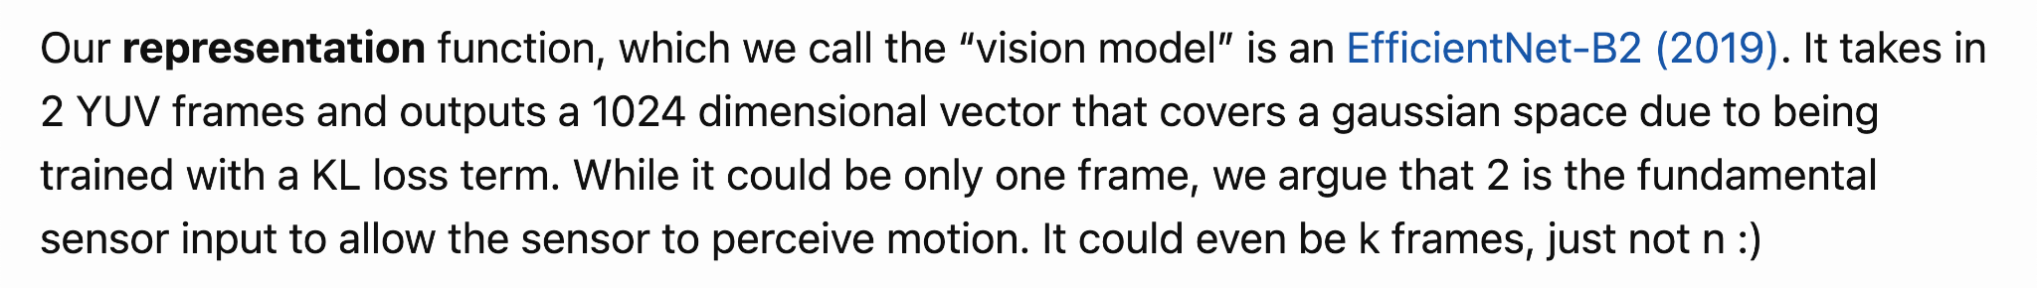
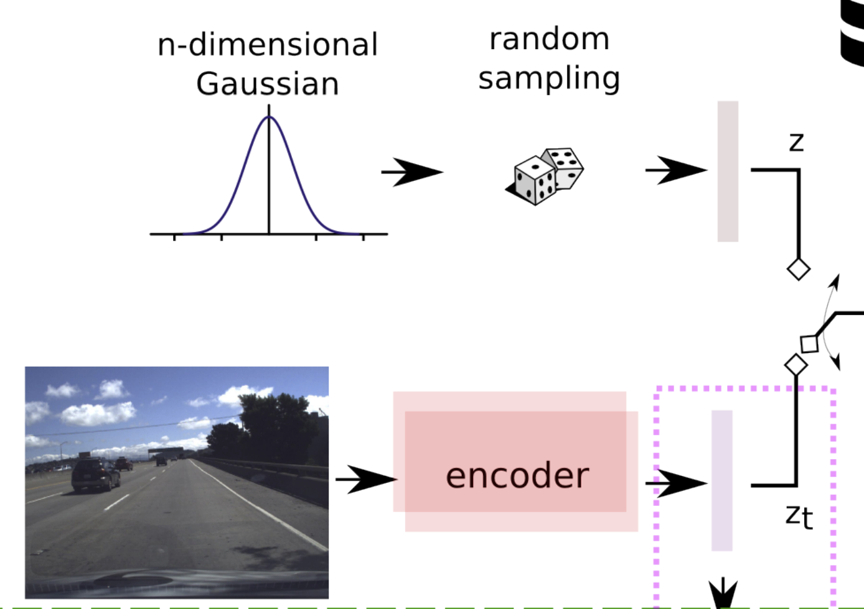
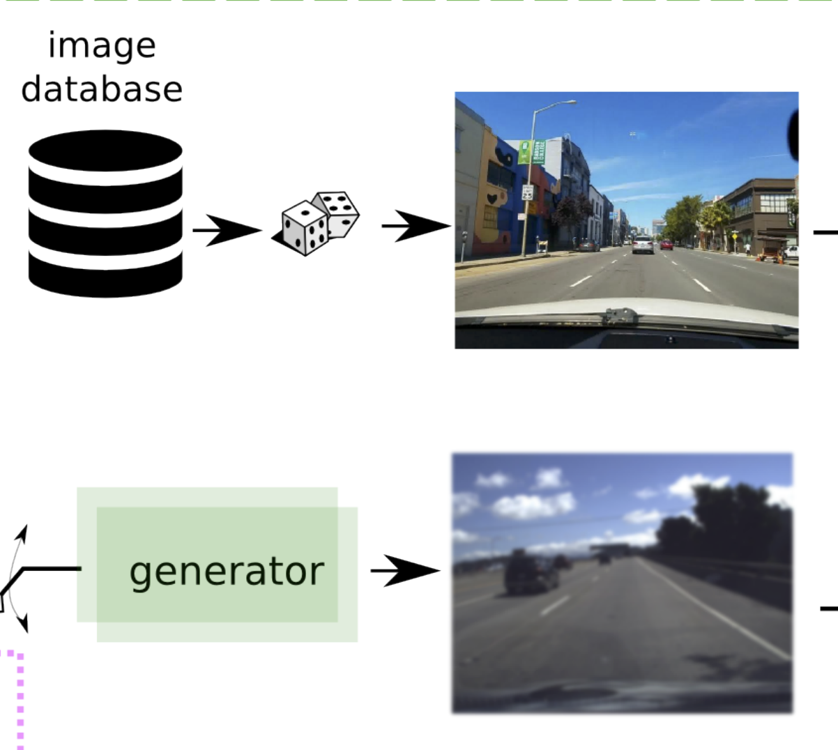
Vision model (aka 'representation')
THIS IS JUST A VAE AND A GAN

Slide 14
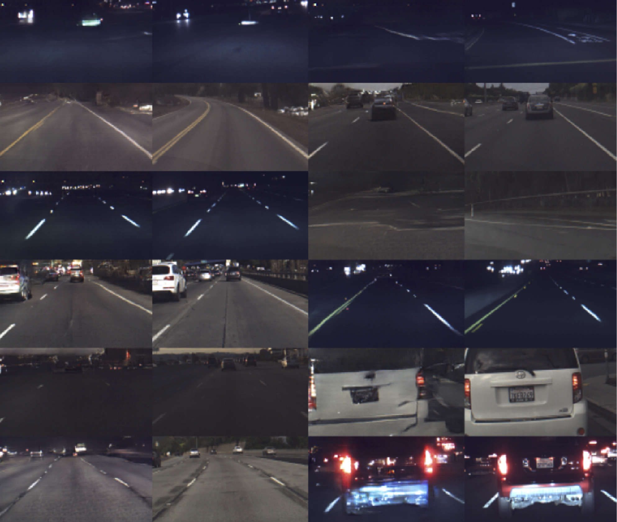
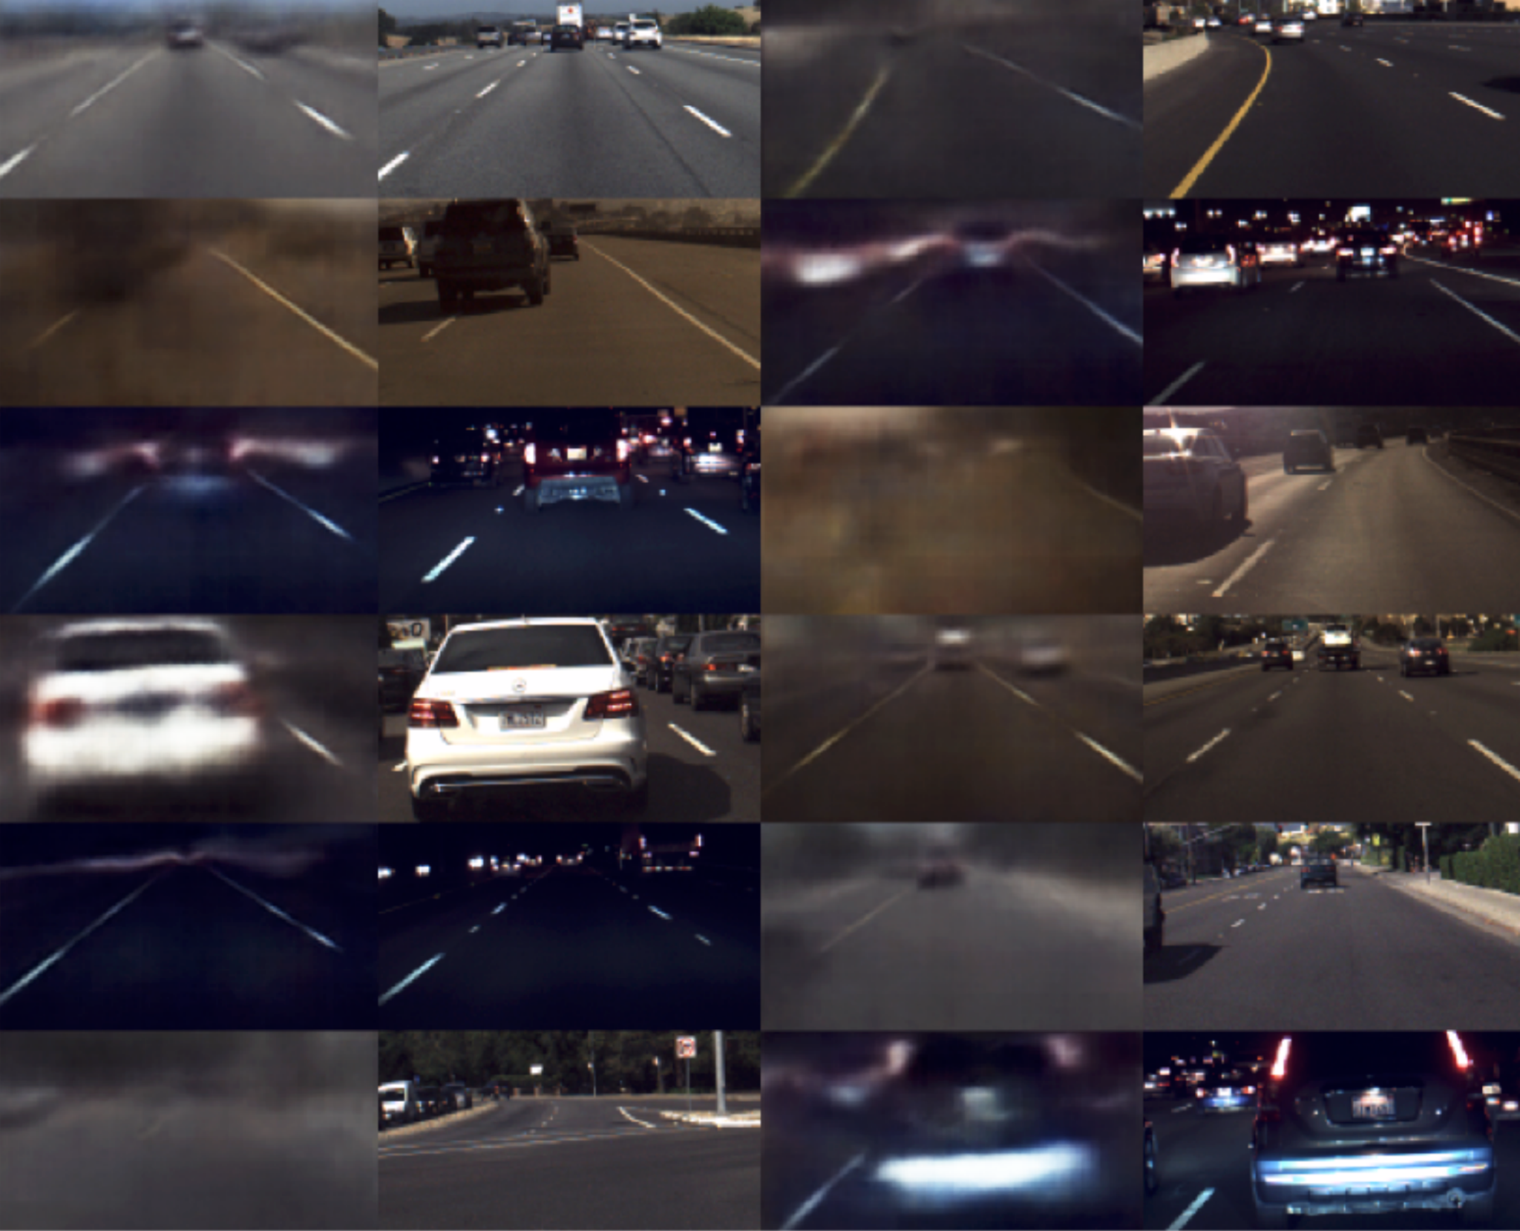
Some results

Slide 15
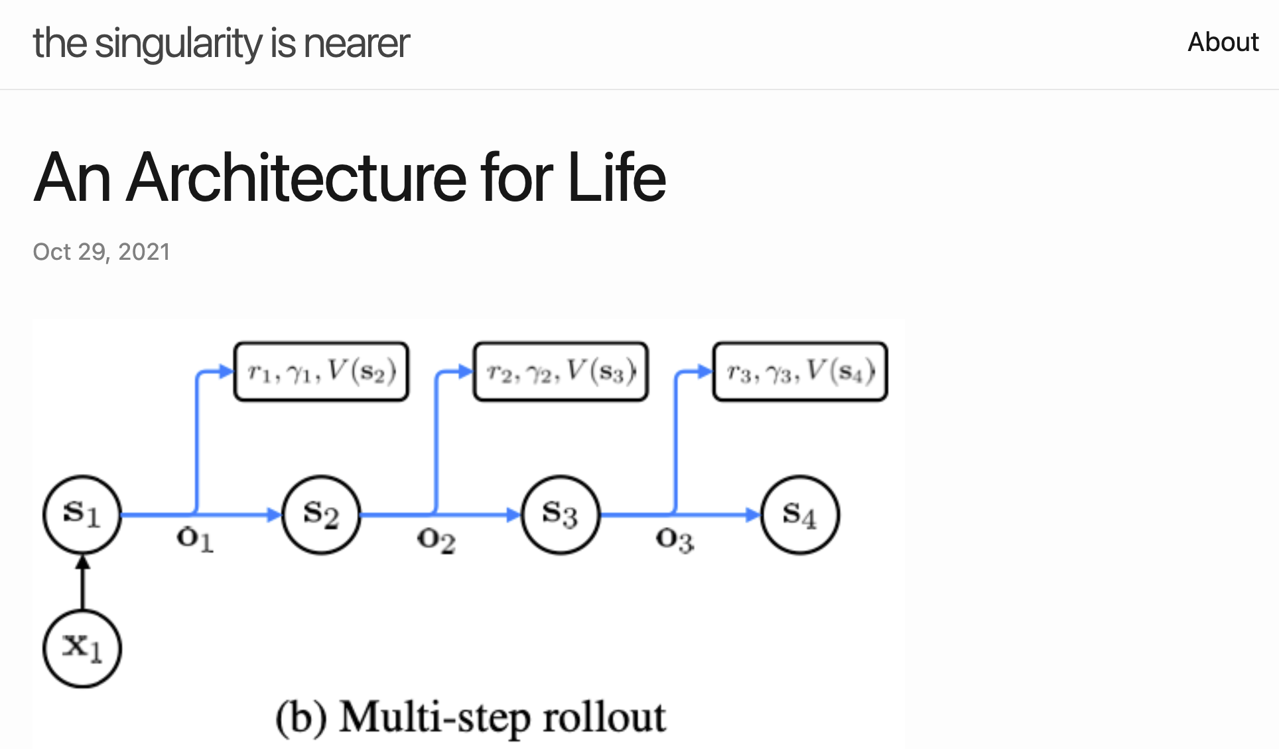
What if it was also MuZero

Slide 16
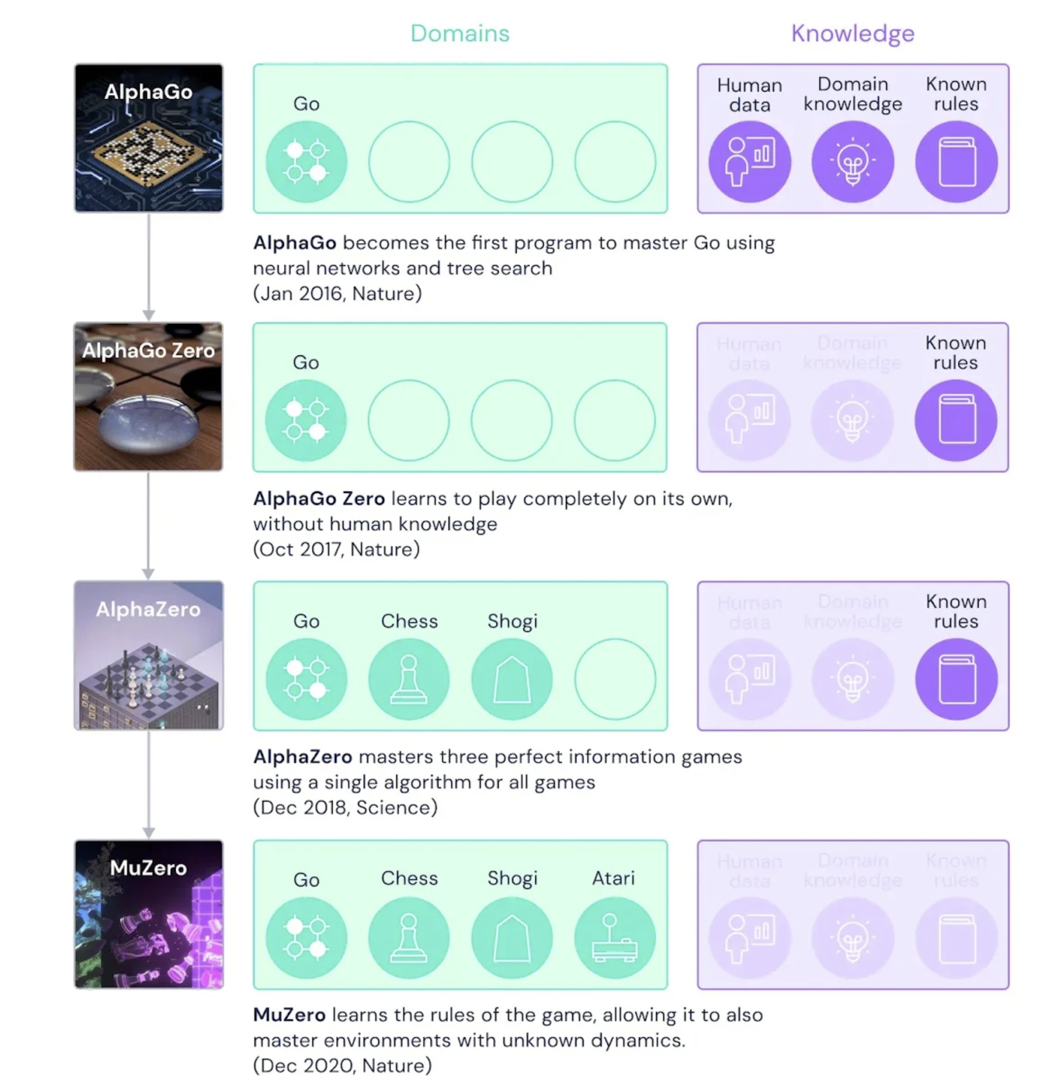
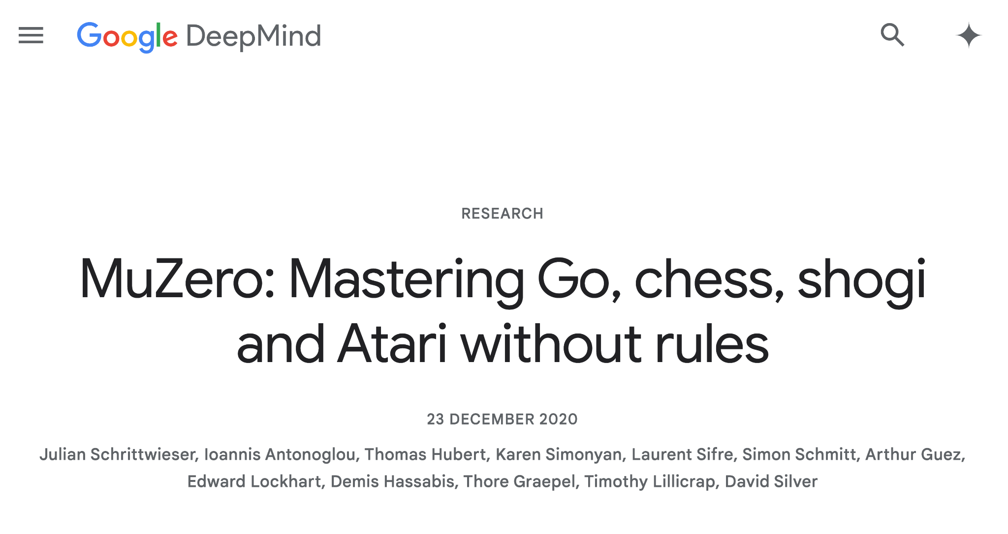
What if it was also MuZero

Slide 17
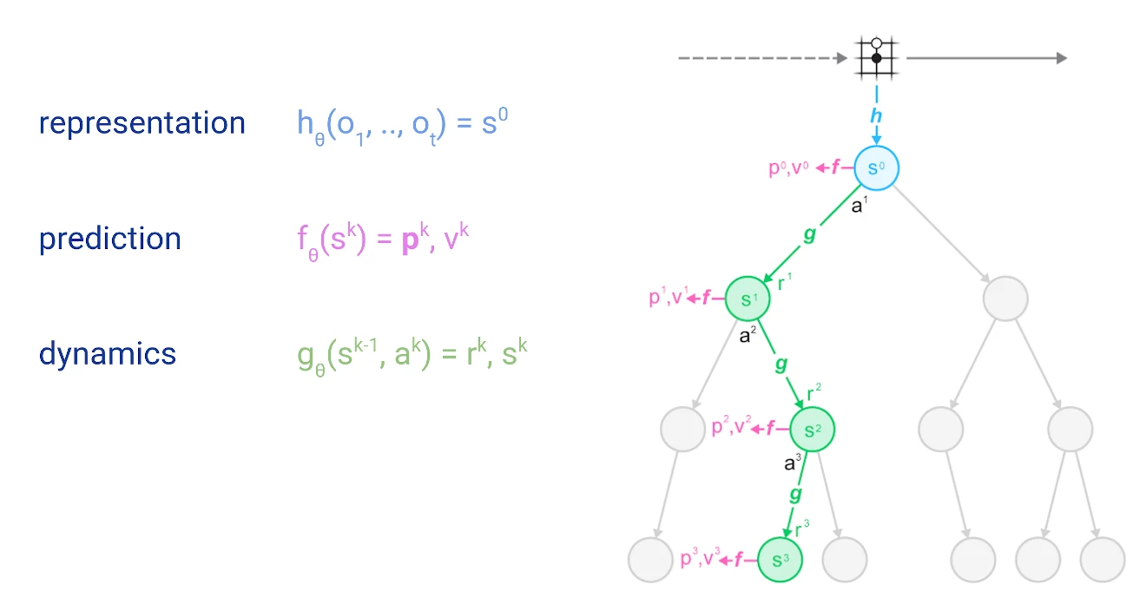
What if it was also MuZero
AlphaGo -> AlphaZero -> MuZero.
Less and less knowledge.
More and more bitter.
Is driving the same?

Slide 18
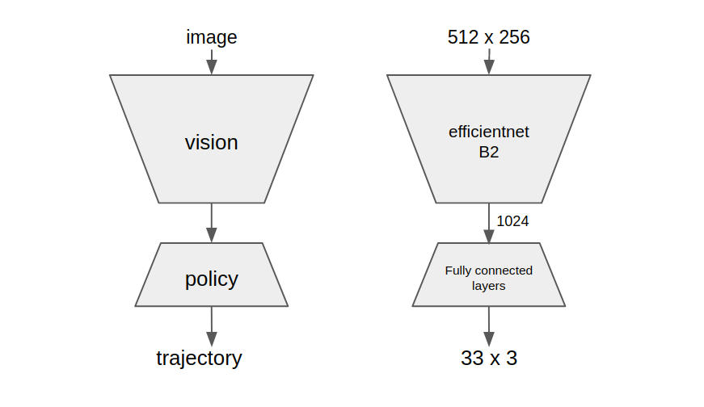
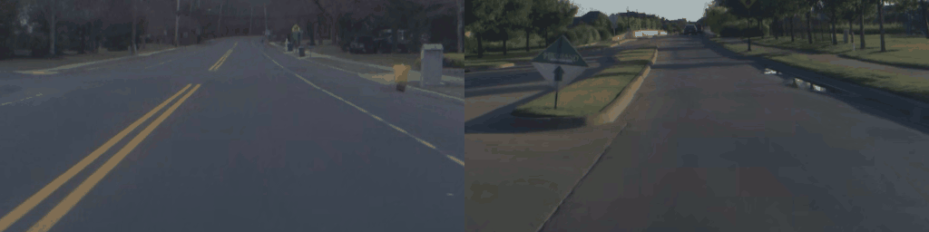
Transition Model (aka 'dynamics')

Slide 19
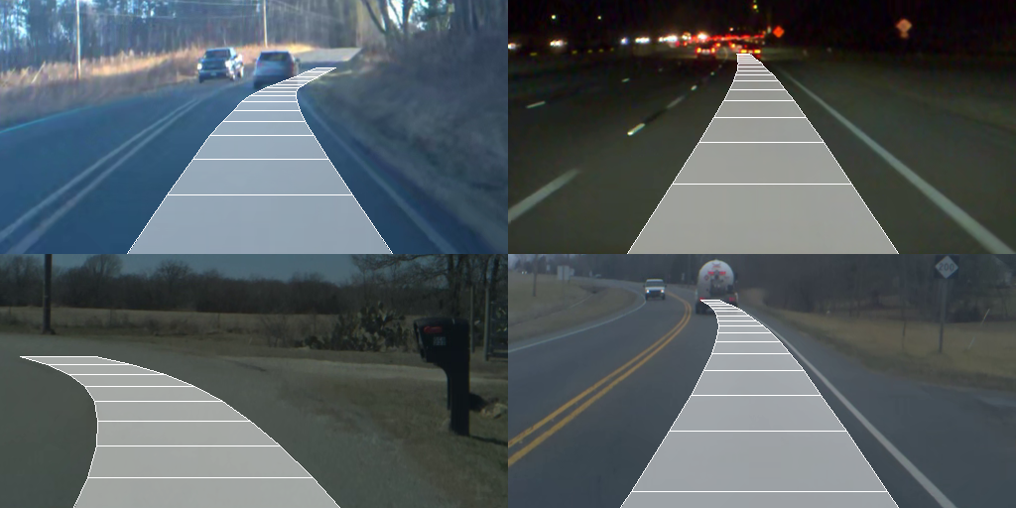
Policy Model
Condition not on "driving performance", but whether human disengages.
Kinda like RLHF.

Slide 20
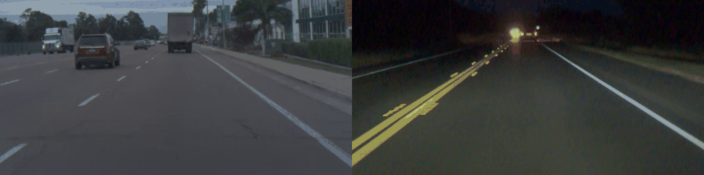
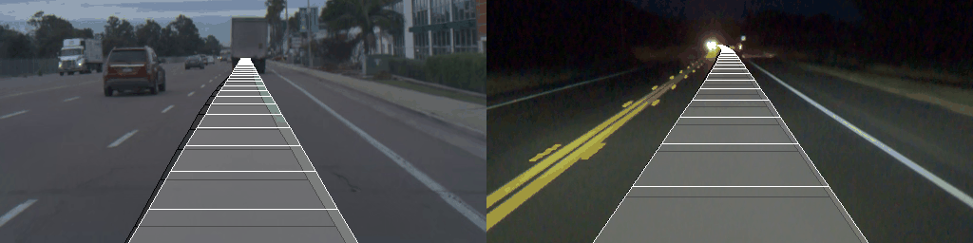
Does MuDriving work?
Artifacts, domain drift, instability, ....

Slide 21
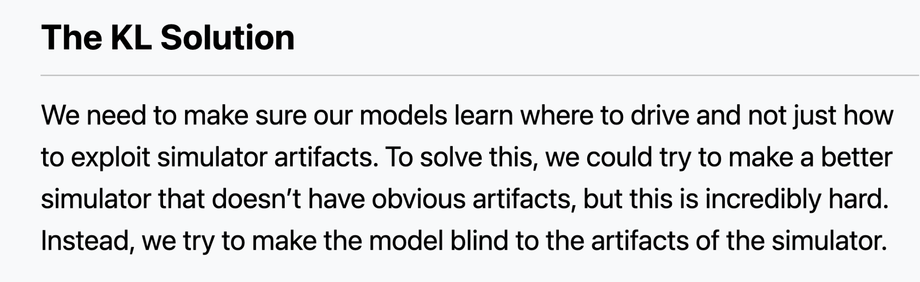
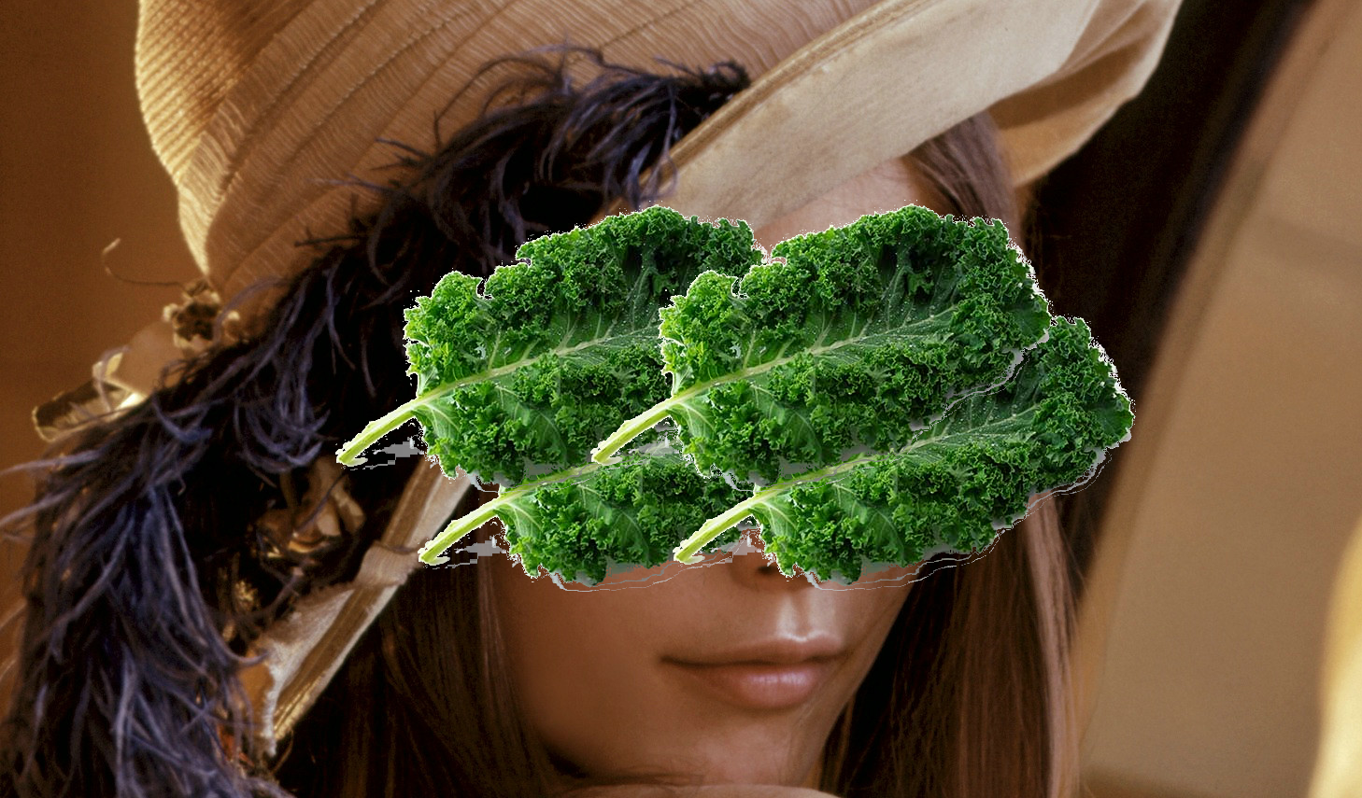
Does MuDriving work?

Slide 22
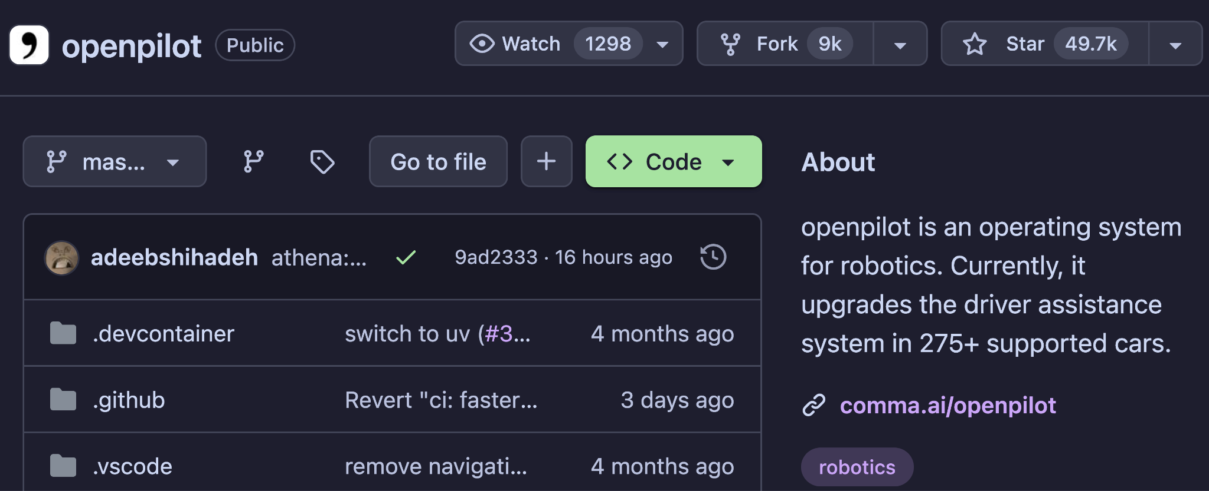
Does MuDriving work?
"That's an insurance problem" - George Hotz

Slide 23
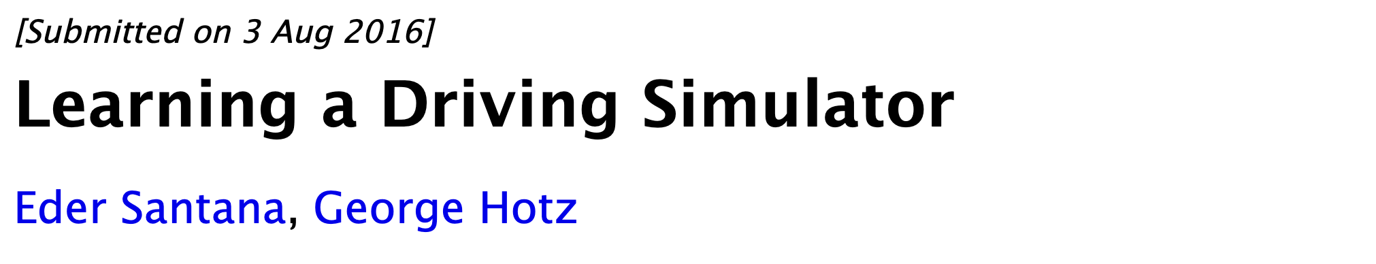
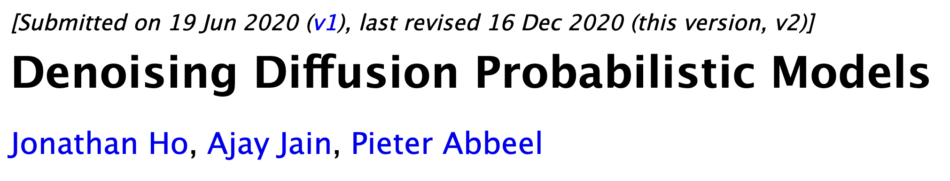
Practical synthetic data generation
Unclear on inspection what the synthetic data is 'for'.

Slide 24
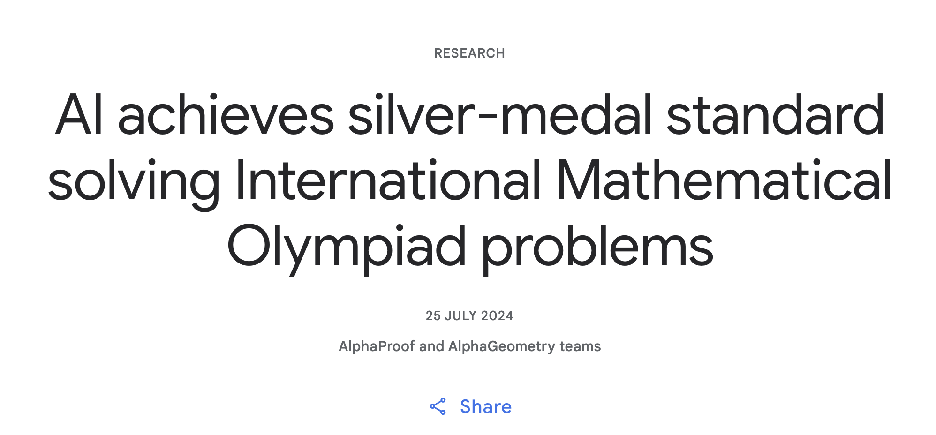
WHAT IF it's all MuZero?

Slide 25
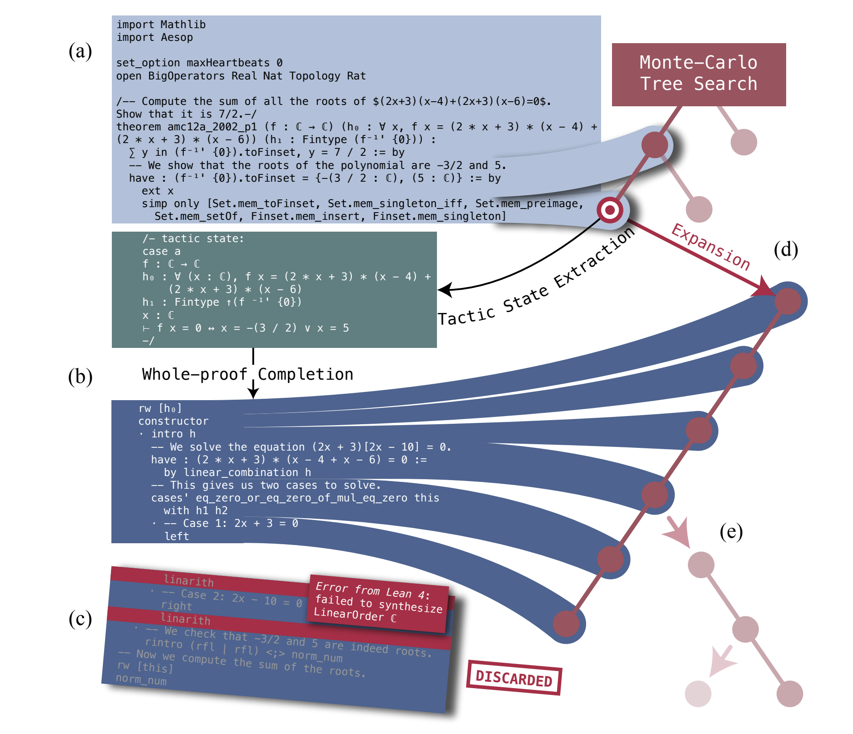
WHAT IF ITS ALL MUZERO?????
- Characters are moves.
- Games are programs.
- Win/loss is compilation in formal language like Lean.
- We have the representation / dynamics model (LLMs).
- We have the critic.
Is math tractable????

Slide 26
Sources
https://arxiv.org/pdf/1608.01230
https://blog.comma.ai/end-to-end-lateral-planning/
https://geohot.github.io/blog/jekyll/update/2021/10/29/an-architecture-for-life.html
https://www.cs.utexas.edu/~eunsol/courses/data/bitter_lesson.pdf
https://arxiv.org/abs/1911.08265
claude.ai

Slide 27
Questions?

